Slide 1
Software Engineering
Prepared by: Neha Tripathi

Slide 2
Emergence of Software Engineering
➢Innovations and experiences (Continued)High level language programmingControl flow based designData structure oriented DesignData flow oriented DesignObject – oriented Design➢The improvement of the software design methodology over the last 50 yrs have indeed been remarkable.
➢Innovations and experiences (Continued)High level language programmingControl flow based designData structure oriented DesignData flow oriented DesignObject – oriented Design➢The improvement of the software design methodology over the last 50 yrs have indeed been remarkable.
Software engineering discipline is the result of advancement in the field of technology. In this section, we will discuss various innovations and technologies that led to the emergence of software engineering discipline.

Slide 3
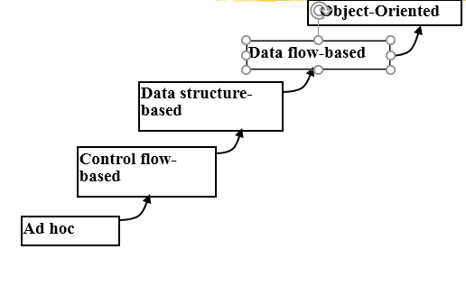
Emergence of Software Engineering

Slide 4
Early Computer Programming (1950s):
(Exploratory programming style)
  Programs were being written in assembly language.
  Programs were limited to about a few hundreds of lines of assembly code.
  Every programmer developed his own style of writing programs:
  -according to his intuition (exploratory programming).

Slide 5
High-Level Language Programming (Early 60s)
High-level languages such as FORTRAN, ALGOL, and COBOL were introduced:
  This reduced software development efforts greatly.
Software development style was still exploratory.
  Typical program sizes were limited to a few thousands of lines of source code.

Slide 6
Control Flow-Based Design (late 60s)
Size and complexity of programs increased further:
  exploratory programming style proved to be insufficient.
Programmers found:
-very difficult to write cost-effective and correct programs.
Programmers found:
  -programs written by others very difficult to understand and maintain.
To cope up with this problem, experienced programmers advised: ``Pay particular attention to the design of the program's control structure.'’
A program's control structure indicates:
  the sequence in which the program's instructions are executed.
To help design programs having good control structure:
  flow charting technique was developed.

Slide 7
Using flow charting technique:
  one can represent and design a program's control structure.
  Usually one understands a program:
    by mentally simulating the program's execution sequence.
A program having a messy flow chart representation:
  difficult to understand and debug.
It was found:
  GO TO statements makes control structure of a program messy
  GO TO statements alter the flow of control arbitrarily.
  The need to restrict use of GO TO statements was recognized.

Slide 8
But, soon it was conclusively proved:
  only three programming constructs are sufficient to express any programming logic:
    sequence (e.g. a=0;b=5;)
    selection (e.g. if(c=true) k=5 else m=5;)
    iteration (e.g. while(k>0) k=j-k;)
Everyone accepted:
  it is possible to solve any programming problem without using GO TO statements.
  This formed the basis of Structured Programming methodology.

Slide 9
Structured Programming
A program is called structured
  when it uses only the following types of constructs:
    sequence,
    selection,
    iteration
Unstructured control flows are avoided.
Consist of a neat set of modules.
Use single-entry, single-exit program constructs.
However, violations to this feature are permitted:
  due to practical considerations such as:
    -premature loop exit to support exception handling.

Slide 10
Structured programs are:
  Easier to read and understand,
  easier to maintain,
  require less effort and time for development.

Slide 11
Data Structure-Oriented Design (Early 70s)
Soon it was discovered:
  it is important to pay more attention to the design of data structures of a program
    than to the design of its control structure.
Techniques which emphasize designing the data structure:
  derive program structure from it:
    -are called data structure-oriented design techniques.
Example of data structure-oriented design technique:
  Jackson's Structured Programming(JSP) methodology
    -developed by Michael Jackson in 1970s.

Slide 12
JSP technique:
  program code structure should correspond to the data structure.
In JSP methodology:
  a program's data structures are first designed using notations for
    sequence, selection, and iteration.
  Then data structure design is used :
    to derive the program structure.
Several other data structure-oriented Methodologies also exist:
  e.g., Warnier-Orr Methodology.

Slide 13
Data Flow-Oriented Design (Late 70s)
Data flow-oriented techniques advocate:
  the data items input to a system must first be identified,
  processing required on the data items to produce the required outputs should be determined.
Data flow technique identifies:
  different processing stations (functions) in a system
  the items (data) that flow between processing stations.
Data flow technique is a generic technique:
  can be used to model the working of any system
    not just software systems.
A major advantage of the data flow technique is its simplicity.

Slide 14
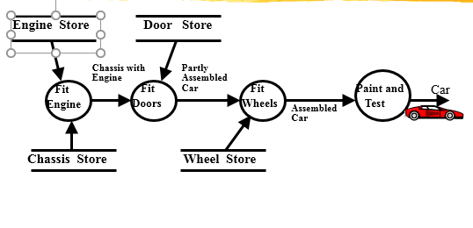
Data Flow Model of a Car Assembly Unit

Slide 15
Object-Oriented Design (80s)
Object-oriented technique:
  an intuitively appealing design approach:
  natural objects (such as employees, pay-roll-register, etc.) occurring in a problem are first identified.
Relationships among objects:
  such as composition, reference, and inheritance are determined.
Each object essentially acts as
  a data hiding (or data abstraction) entity.
Object-Oriented Techniques have gained wide acceptance:
  Simplicity
  Reuse possibilities
  Lower development time and cost
  More robust code
  Easy maintenance

Slide 16
Differences between the exploratory style and modern software development practices
Use of Life Cycle Models
Software is developed through several well-defined stages:
  requirements analysis and specification,
  design,
  coding,
  testing, etc.
Emphasis has shifted
  from error correction to error prevention.
Modern practices emphasize:
  detection of errors as close to their point of introduction as possible.

Slide 17
In exploratory style,
  errors are detected only during testing,
Now,
  focus is on detecting as many errors as possible in each phase of development.
In exploratory style,
  coding is synonymous with program development.
Now,
  coding is considered only a small part of program development effort.
A lot of effort and attention is now being paid to:
  requirements specification.
Also, now there is a distinct design phase:
  standard design techniques are being used.

Slide 18
During all stages of development process:
  Periodic reviews are being carried out
Software testing has become systematic:
  standard testing techniques are available.
There is better visibility of design and code:
  visibility means production of good quality, consistent and standard documents.
  In the past, very little attention was being given to producing good quality and consistent documents.
  We will see later that increased visibility makes software project management easier.

Slide 19
Because of good documentation:
  fault diagnosis and maintenance are smoother now.
Several metrics are being used:
  help in software project management, quality assurance, etc.
Projects are being thoroughly planned:
  estimation,
  scheduling,
  monitoring mechanisms.
Use of CASE tools.

Slide 20
Thank you!

